Slide 1
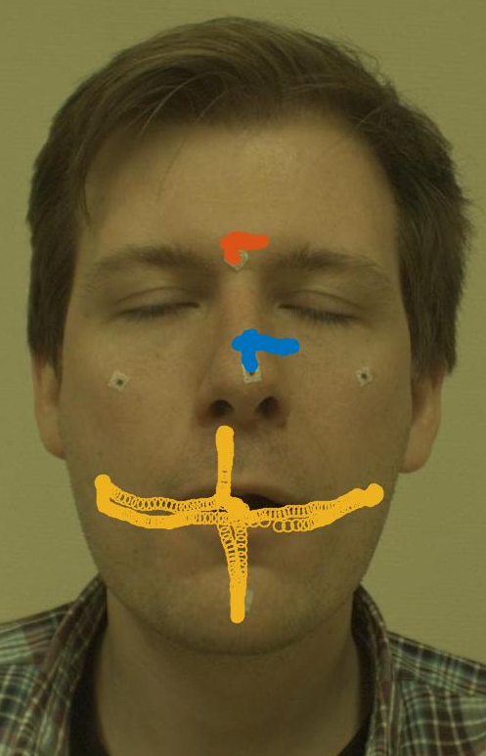
Project 4 – 3d Tracking of facial features
Image Processing and computer Vision
Tracking an individual tongue for determining range of motion

Slide 2
Methodology
Camera calibration
Selecting Regions of Interest (ROI)
Tracking Regions of Interest in 2D
Triangulating the ROIs in 3D space
Range of motion estimation from fixed coordinate system on subject’s face.

Slide 3
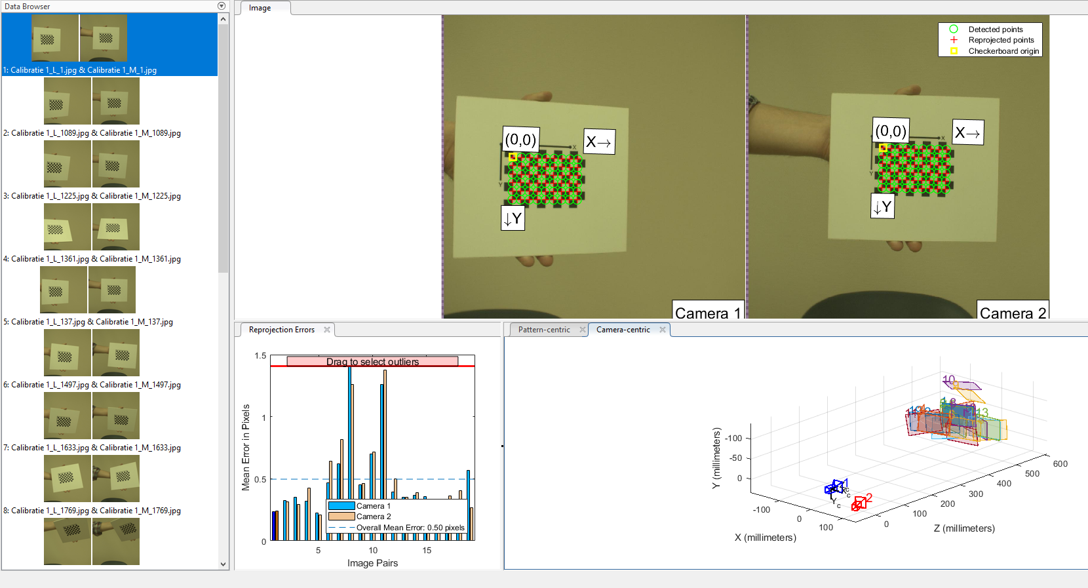
Camera calibration
The pairs of stereo cameras were calibrated using the Camera Calibration toolbox for MATLAB.
This gives us camera extrinsics and intrinsics like camera focal length, skew coefficient, distortions, rotations and translations.
A standardized checkerboard pattern of size 10mm is used to estimate the camera properties.
Notes:
Talk about what the output of the camera calibration is.

Slide 4
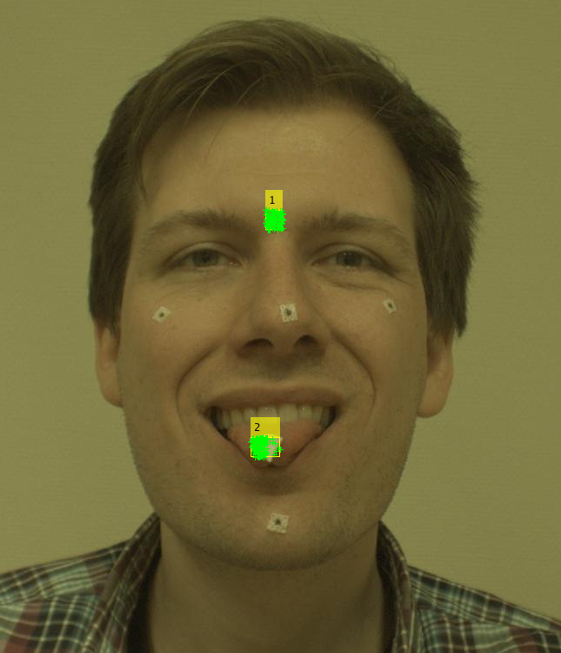
2D Tracking – Regions of Interest
For tracking in 2D, a static reference region and the tracking region is manually selected.
Then points are generated in the ROI using the Eigen Features algorithm.
Notes:
Describe how the Eigen features algorithm works?

Slide 5
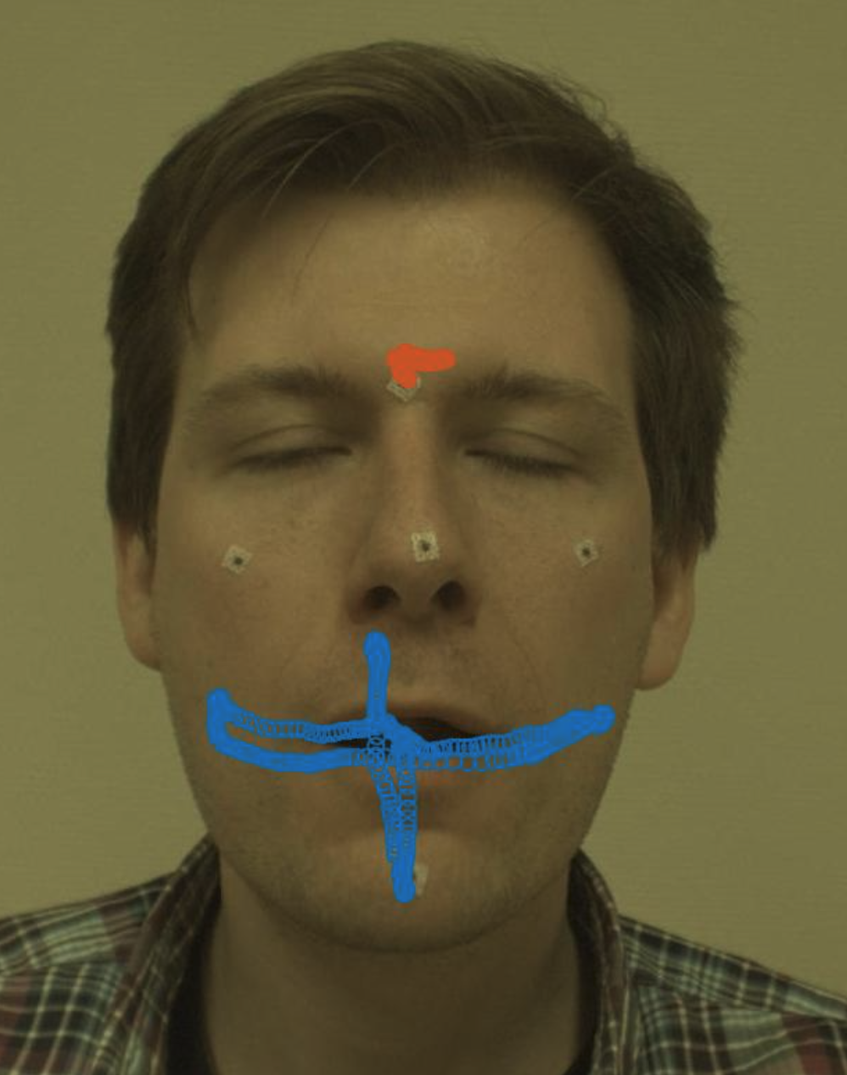
2D Tracking – Tracking points
Using the Kanade-Lucas-Tomasi (KLT) feature tracking algorithm, we track the set of points generated from the ROI bounding boxes.
When the tongue disappears, the video is paused and skipped forward to reselect the ROI for the tongue.
RANSAC is used to reject outliers to any of the path data generated by the tracking algorithm.
Notes:
The skipping of frames is manual.
Describe KLT in more detail.

Slide 6
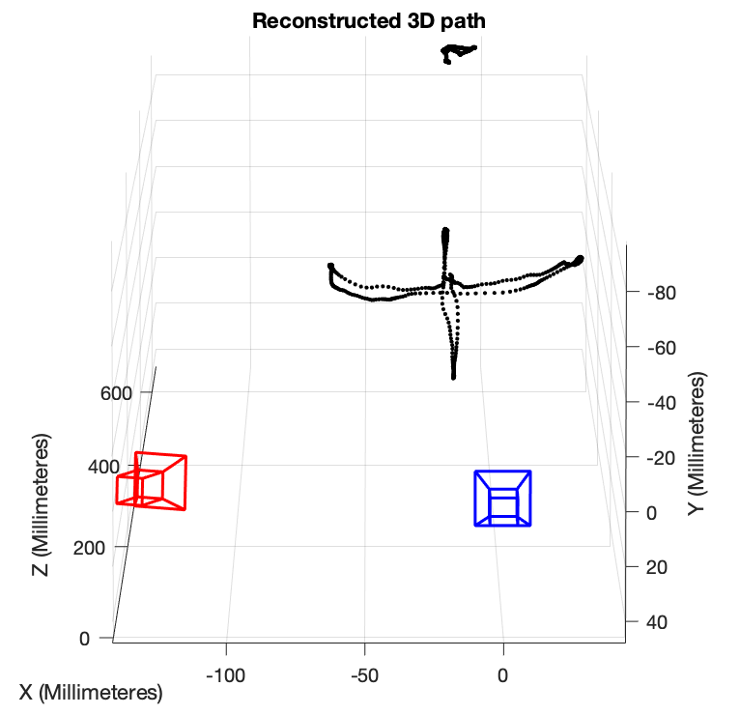
Triangulating the ROIs in 3D space
Using a set of matched points (2D paths from two 2D tracking videos) and the camera stereo parameters, generate the path in 3D space w.r.t to the WorldSpace.
Notes:
Assuming frames are undistorted (this was done as a computation time saving step?), we can use the

Slide 7
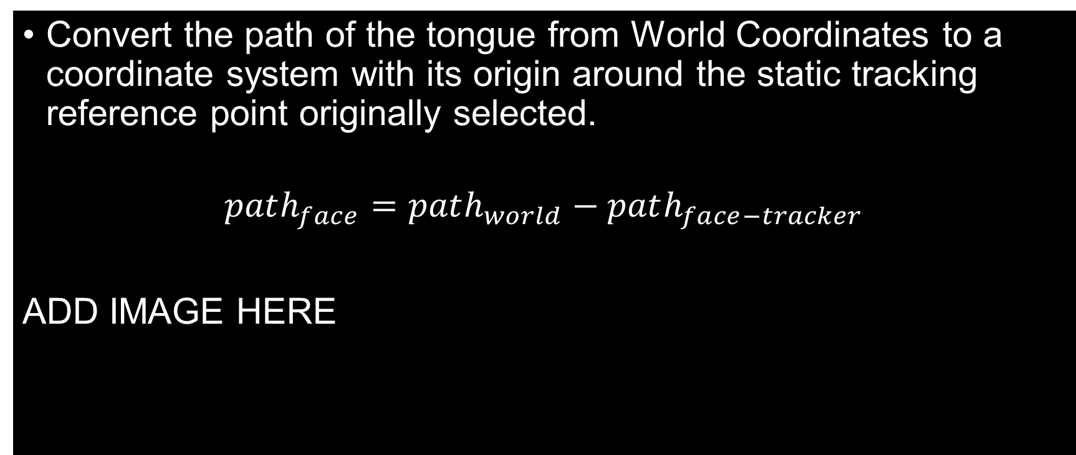
Range of motion estimation from fixed coordinate system on subject’s face.
Convert the path of the tongue from World Coordinates to a coordinate system with its origin around the static tracking reference point originally selected.
$$path_{face}=path_{world}−path_{face−tracker}$$
ADD IMAGE HERE
Notes:
Assuming frames are undistorted (this was done as a computation time saving step?), we can use the

Slide 8
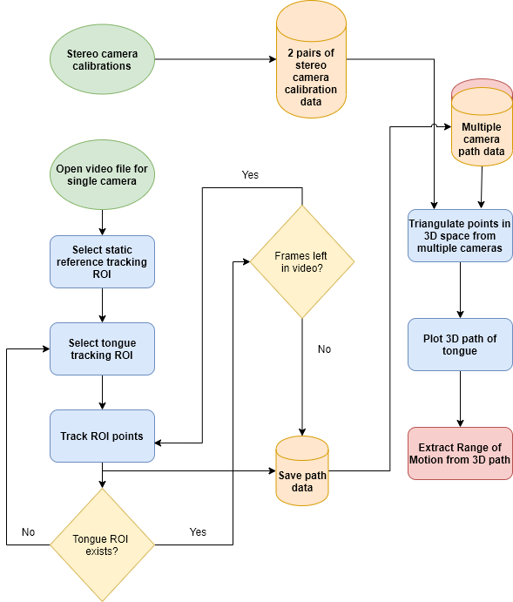
Conclusion
For subject 1 the Range of Motion estimated is _____
This estimate could be further improved by ________

